Slide 1
Touch & Multi-touch
Multiview & Tab Bars
TMA Training Center (TTC)
Course | iPhone application development
Trainer | Thuong Tran
Designed by | TMA Mobile Solutions (TMS)
Last updated | 28 Feb 2011

Slide 2
This section objectives
Understanding about Touch and Multi-touch, Multiview and Tab Bars in iPhone Development

Slide 3
Content
Touch
Multi – touch
Multiview Application
Tab Bars Controller
Project assignment: implementation

Slide 4
Touch Events

Slide 5
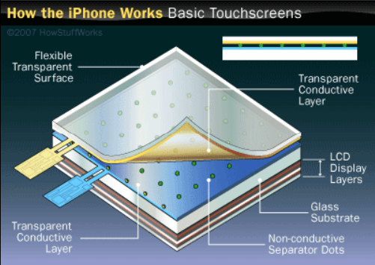
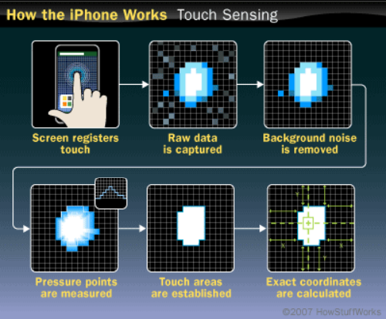
iPhone Touch Introduction

Slide 6
Single Touch: UITouch
A single touch or stroke (as long as it stays on the screen)
Each touch is a UIEvent (UITouch object inside of it)
  @property(nonatomic,readonly) NSTimeInterval timestamp;
  @property(nonatomic,readonly) UITouchPhase phase;
  @property(nonatomic,readonly) NSUInteger tapCount;
  @property(nonatomic,readonly,retain) UIWindow *window; @property(nonatomic,readonly,retain) UIView *view;
  -(CGPoint)locationInView:(UIView *)view;
  -(CGPoint)previousLocationInView:(UIView *)view;

Slide 7
Touch Event Handlers
UIResponder class defines an interface for objects that respond to and handle events.
UIApplication will forward events to the UIApplicationDelegate (your view controller class which implements the <UIApplicationDelegate> protocol)
The event handlers below will handle those events – you define what happens!
  -(void)touchesBegan:(NSSet *)touches withEvent:(UIEvent*)event;
  -(void)touchesMoved:(NSSet *)touches withEvent:(UIEvent*)event;
  -(void)touchesEnded:(NSSet *)touches withEvent:(UIEvent*)event;
  -(void)touchesCancelled:(NSSet *)touches withEvent:(UIEvent*)event;

Slide 8
Multi-Touch

Slide 9
MultiTouch: UIEvent
UIEvent is used to group one or more touches in a container
Contains the following property and methods
  @property(nonatomic,readonly) NSTimeInterval timestamp;
  -(NSSet *)allTouches;
  -(NSSet *)touchesForWindow:(UIWindow *)window;
  -(NSSet *)touchesForView:(UIView *)view;

Slide 10
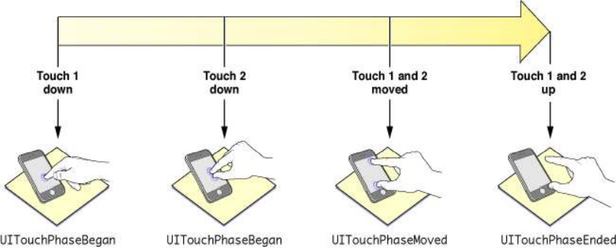
Multi-Touch: UIEvent

Slide 11
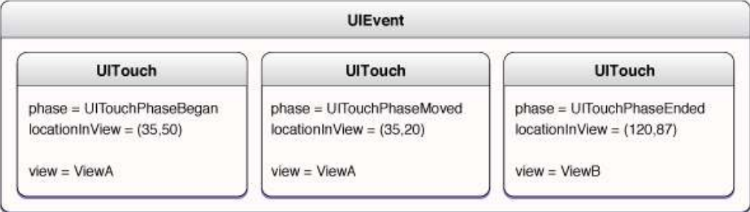
UIEvent Object
The UIEvent object contains several UITouch objects

Slide 12
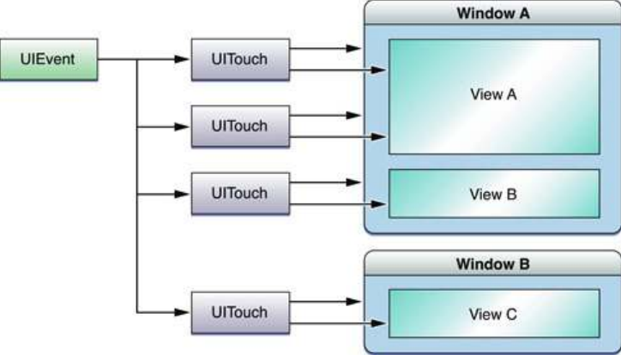
MultiTouch: UIEvent
All touches: -(NSSet *)allTouches;

Slide 13
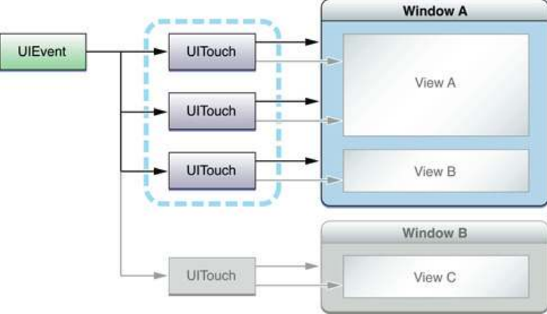
MultiTouch: UIEvent
Window specific touches:
  -(NSSet *)touchesForWindow:(UIWindow *)window;

Slide 14
Handling Tap Gestures
-(void)touchesEnded:(NSSet *)touches withEvent:(UIEvent *)event {
for (UITouch *touch in touches) {
if (touch.tapCount >= 2) {
// Do something such as change colour
}
}
}

Slide 15
Enabling MultiTouch
By default multi-touch is disabled on iPhone applications
You can enable it by setting the UIView Property
  BOOL multipleTouchEnabled
You can even disable all touch events by setting the view’s userInteractionEnabled property to NO.

Slide 16
UIControlEvents
UIControlEventTouchDown: Finger is touched down inside control
UIControlEventTouchDragInside: Finger is dragged inside bounds of control
UIControlEventTouchDownRepeat: Repeated touch downs (taps greater than one)
UIControlEventTouchDragOutside: Finger is dragged just outside of bounds of control

Slide 17
UIControlEvents
UIControlEventTouchDragEnter: Finger is dragged into the bounds of control
UIControlEventTouchDragExit: Finger is dragged from inside to outside of control bounds
UIControlEventTouchUpInside: Finger is lifted while inside the control bounds
UIControlEventTouchUpOutside: Finger is lifted oustide of control bounds
UIControlEventTouchCancel: A system event canceling the touches for the control

Slide 18
Touch Callbacks
The view returned by: You must handle all of the touch processing methods if you plan to only use one:
-(void)touchesBegan:(NSSet *)touches withEvent:(UIEvent *)event;
-(void)touchesMoved:(NSSet *)touches withEvent:(UIEvent *)event;
-(void)touchesEnded:(NSSet *)touches withEvent:(UIEvent *)event;
-(void)touchesCancelled:(NSSet *)touches withEvent:(UIEvent *)event;

Slide 19
Single/Multi-Touch Demo

Slide 20
Exercise 1
Create a project that have 1 button
Touch and move this button

Slide 21
Exercise 2
Create a rating bar that have 5 stars:
  Tab to rate
  Slide to rate
A label show your rating (1-10)

Slide 22
Multiview Application

Slide 23
The Architecture of Multiview Application
Nib file is the key player
Inside the Nib file:
  Application Delegate
  Application’s Main Window
  Root-view controller
Root-view controller is responsible for managing which other view is currently being shown to the user
Root-view may be a UINavigationController, UITabBarController, or a custom ViewController.

Slide 24
Multiview Controllers
Multiview controllers are View controllers
  Root-view controller are subclass of ViewController
In Multiview application, most of screen will taken up by a content view. Each content view have its own controller with its outlets and actions.
  In Tab Bar App: event click tab bar is sent to tab bar controller

Slide 25
Multiview Controller Demo

Slide 26
Animating the Transition in Multiview Application
iPhone support 4 view transition
  UIViewAnimationTransitionFlipFromLeft
  UIViewAnimationTransitionFlipFromRight
  UIViewAnimationTransitionCurlUp
  UIViewAnimationTransitionCurlDown

Slide 27
Animating the Transition in Multiview Application
Steps to animate:
  [self.view addSubview: aView];
  [UIView beginAnimation:0 context:nil];
  [UIView setAnimationDuration:1];
  [UIView setAnimationCurve:UIViewAnimationCurveEaseInOut];
  [UIView setAnimationTransition: UIViewAnimationTransitionFlipFromRightForView:self.view cache:NO];
  [UIView commitAnimations]

Slide 28
Animating the Transition in Multiview Application Demo

Slide 29
Tab Bar Controller

Slide 30
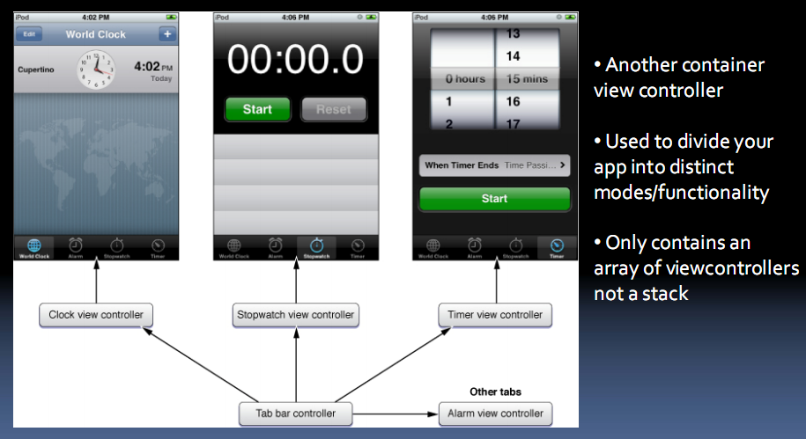
Tab Bar Controller

Slide 31
Creating a Tab Controller
‐(void)applicationDidFinishLaunching{
  // First alloc/init a tab bar controller
  myTabBarController = [[UITabBarController alloc] init];
  // Assuming you have an array of view controllers, set it to tabcontroller’s property
  myTabBarController.viewControllers = myViewControllers;
  // Add the tab bar controller’s view to the window
  [window addSubview:myTabBarController.view];
}

Slide 32
Adding Titles and Images
‐(void)viewDidLoad {
  //Create a tab bar item and initialize it with title and image
  //Note the image taken is the alpha channel (blue outline if selected)
  UITabBarItem *item = [[UITabBarItem alloc] initWithTitle:@“Recipes”
  image: [UIImage imageNamed:@“food.png”] tag:0];
  self.tabBarItem = item;
  [item release];
}

Slide 33
Exercise
Create a project
Main view have 1 button
Click each button will bring a new tab- bar to our app
New tab bar will have 3 tab: First, Second, Third
Each tab have 4 button, when tap one button will bring a new view with different transition.

Slide 34
Tab Bars Controller Demo

